Slide 1


Introduction and Implementation of an AI Based Deepfake Video Detection Application
Instructor:
Prof. Guan Yue Hong
Prepared by :
Poornima Vaidya

Slide 2

CONTENTS
01
Introduction
02
Abstract
03
Dataset
04
Implementation
05
Model Output
06
Future Work

Slide 3
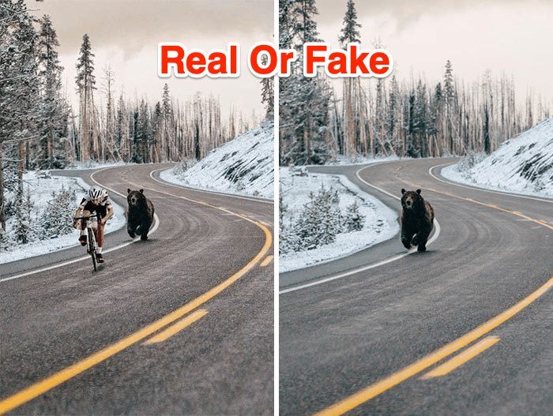
01
Introduction
AI Advancements & Deepfake Threats
Rapid AI progress → Driving innovation across industries
Emerging concern → Rise of deepfake technology
Deepfake capability → Generates hyper-realistic fake videos/images
Key risks:
Erosion of digital trust
Threats to personal privacy
National security vulnerabilities
Urgent need → Robust detection solutions

Slide 4
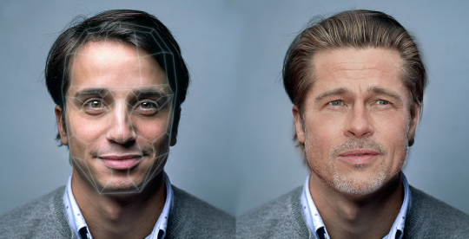
02
Abstract
Rapid deepfake advancement → Harder to detect manipulated videos
Critical need for reliable detection tools
Hybrid AI detection system combining:
Xception CNN: Spatial feature analysis
LSTM: Temporal pattern recognition

Slide 5
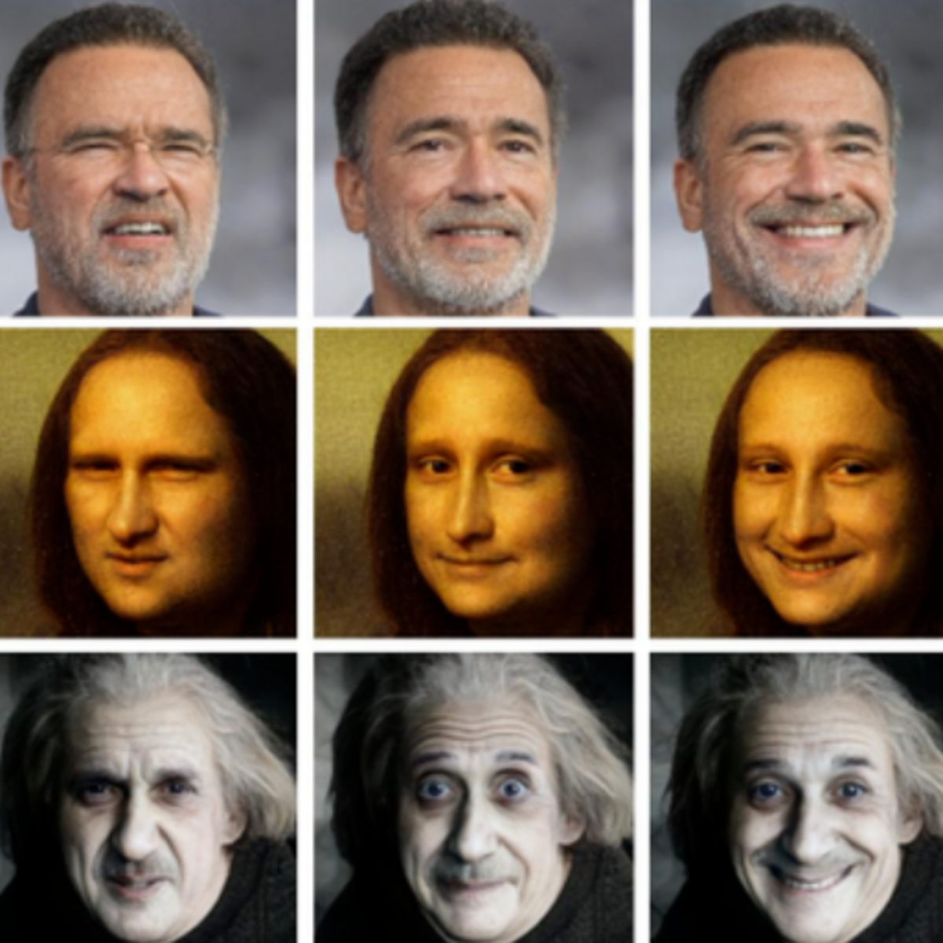
03
Dataset
Dual Content:
Original (real) videos
Manipulated (fake) videos
Perfectly balanced for detection tasks
Technical Specifications:
Duration: 1–45 seconds
Resolution: 1920×1080 (Full HD)
Size: 152KB–28MB (optimized for processing)
Rich Metadata:
Clear "real"/"fake" labels
Manipulation methods:
- Face-swapping
- Facial reenactment

Slide 6
04
Implementation
Model Architecture
Input
Training
Data Preparation
Spatial Feature Extraction
Adam Optimizer Callbacks (ModelCheckpoint, ReduceLROnPlateau)
TimeDistributed Xception
CNN
Real Labeled Videos
Frame Extraction (OpenCV)
Data Augmentation
Rotation, Flip, Zoom
Temporal Analysis
Resizing (128×128)
LSTM Layer
Fake Labeled Videos
Testing & Evaluation
Normalization (0–1)
Classification
Accuracy, Precision, Recall, F1-Score
FaceForensics++ Dataset
Dense Layers (Softmax)
Output
Real
Fake

Slide 7
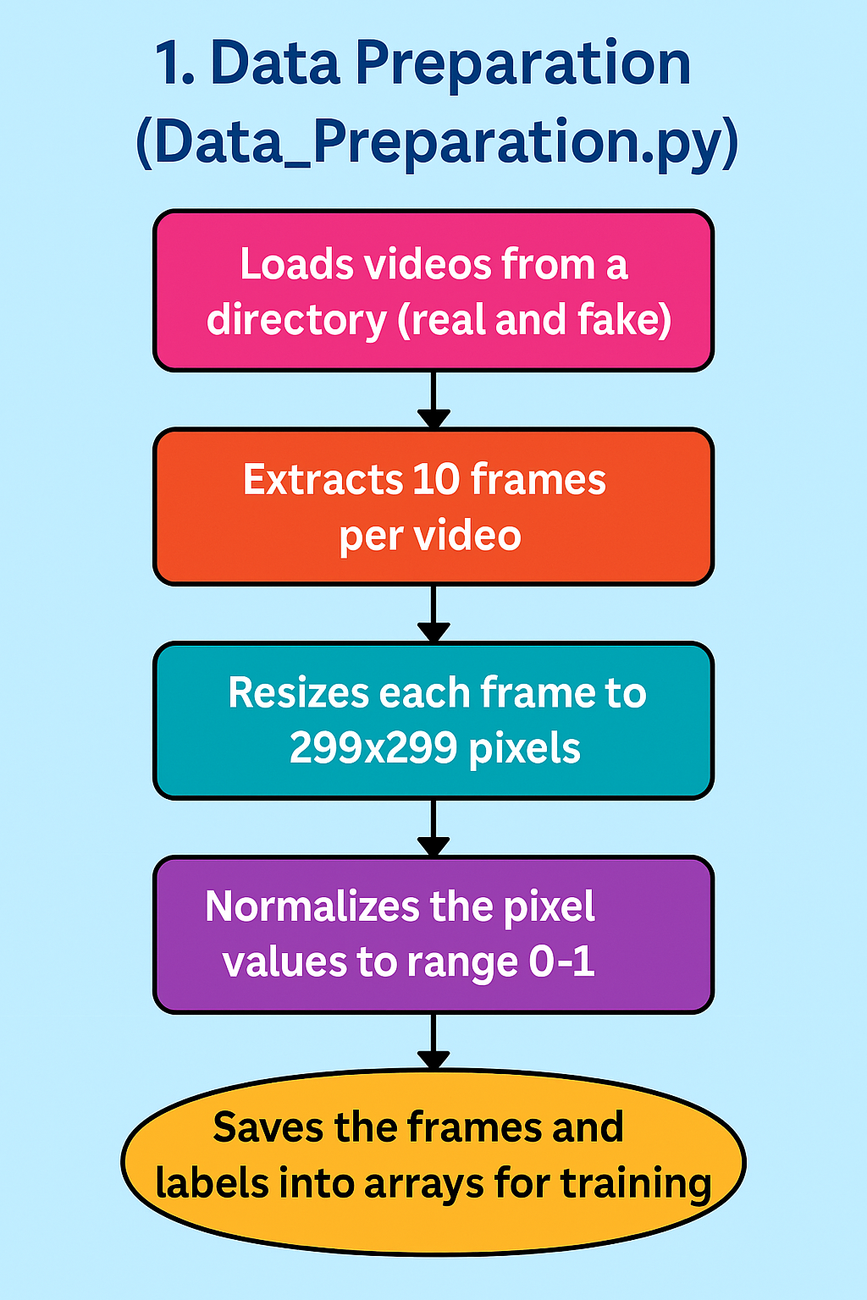
Data Preparation

Slide 8
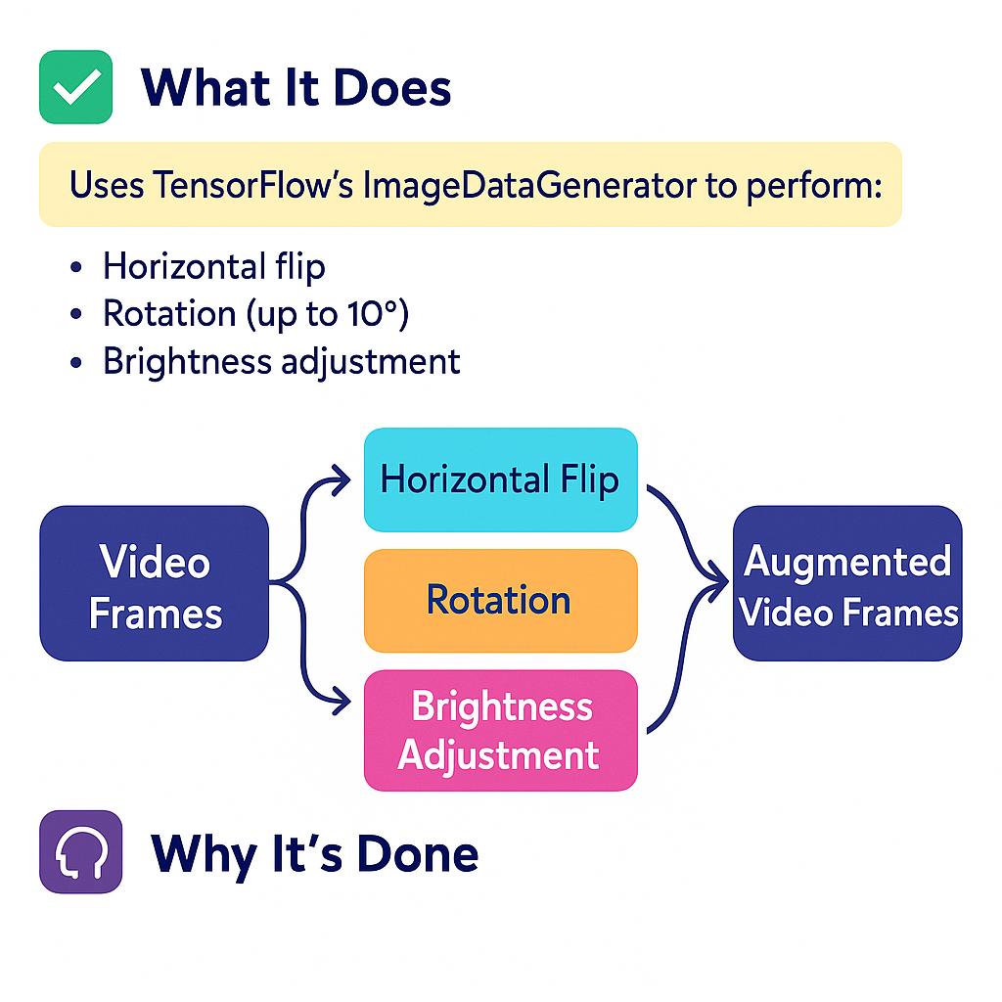
Data Augmentation

Slide 9
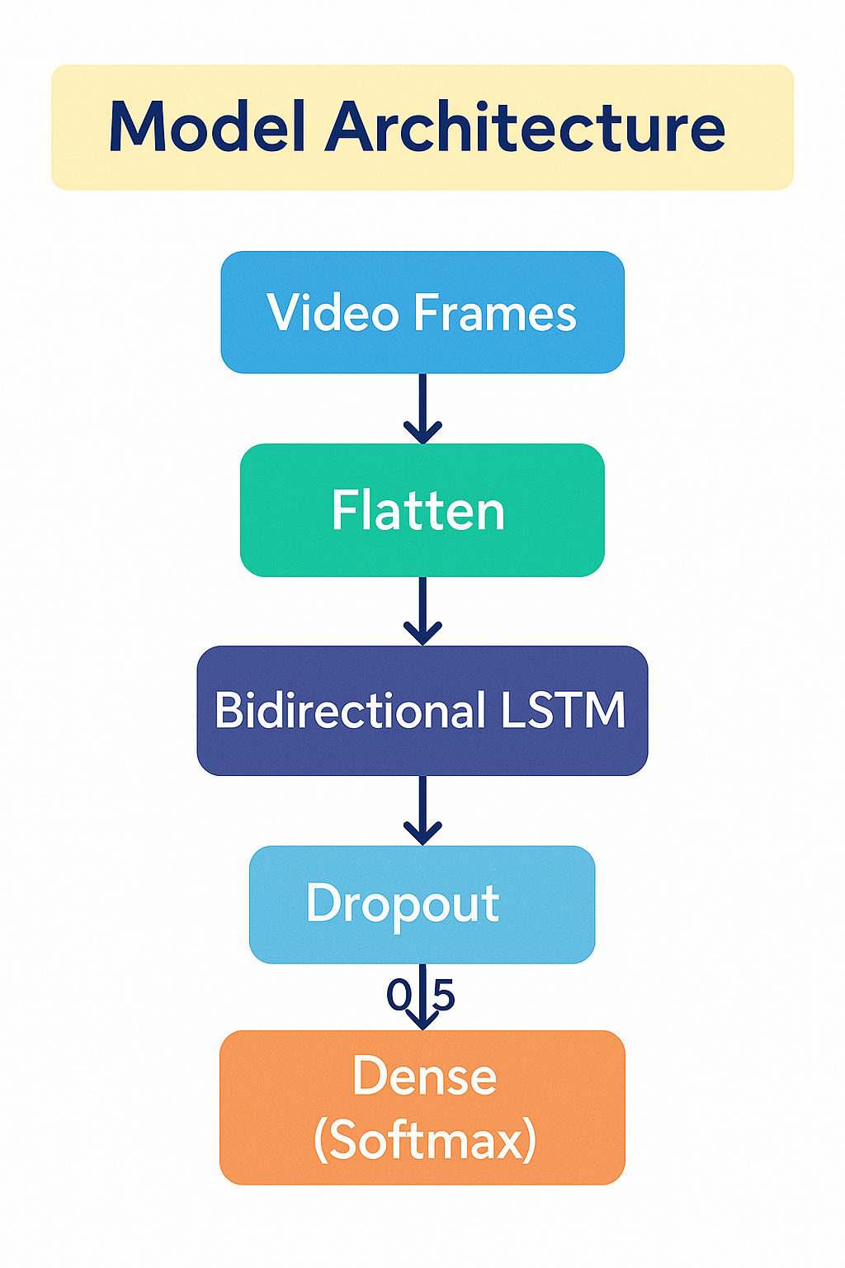
Model Architecture

Slide 10
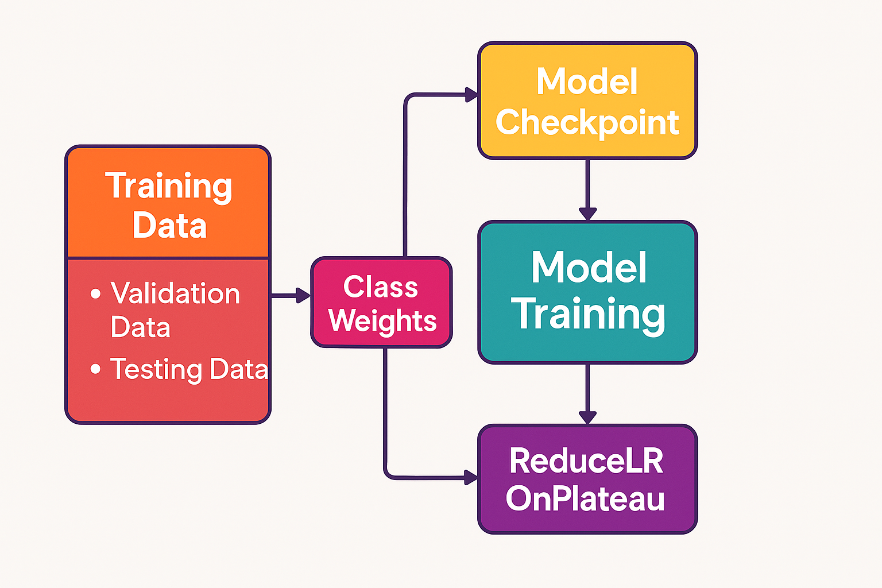
Model Training

Slide 11
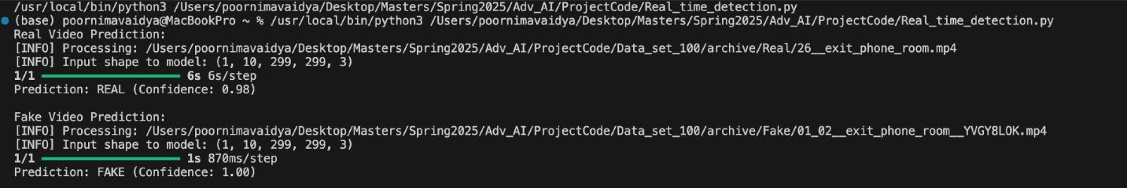
05
Model Output

Slide 12
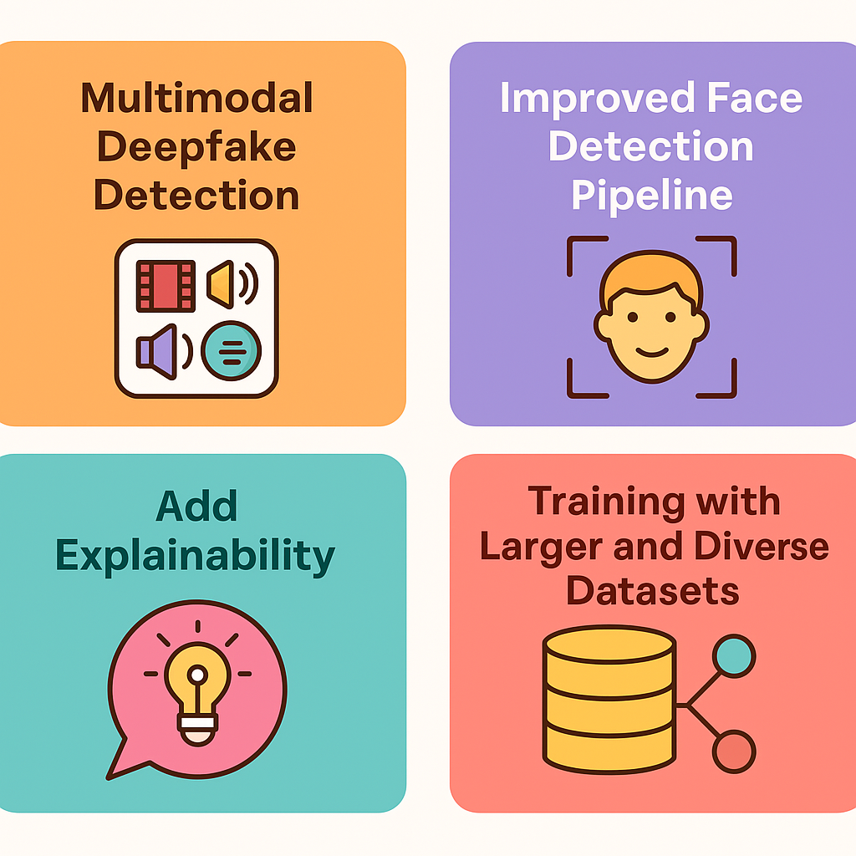
06
Future Work

Slide 13

Thanks

